Slide 1

Element-Hub: The Self-Sustaining Repository
Presented by Willin Broad Kiplimo
A Modular Architecture for Independent Code Cloning

Slide 2
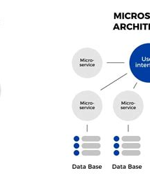
The Problem: "Dependency Hell"
Current State: Modern repositories are monolithic (huge, interconnected blocks of code).
The Issue: To use one feature (e.g., a "Search Bar"), a developer often has to download the entire library.
Consequence: Wasted storage, version conflicts, and slow deployment times.

Slide 3
The Solution: Element-Hub
Definition: A decentralized hosting platform for "Atomic" computer science elements.
Core Concept: Unlike GitHub, which hosts projects, Element-Hub hosts functions.
Key Innovation: Every element is "Self-Sustaining"—it contains its own mini-environment.

Slide 4
The Hub: The central server that indexes available code elements.
The Container: Each element is wrapped in a Docker-style container.
The Manifest: A strict configuration file that prevents the element from relying on external, global variables.
Technical Architecture

Slide 5


Technical Architecture
The Hub: The central server that indexes available code elements.
The Container: Each element is wrapped in a Docker-style container.
The Manifest: A strict configuration file that prevents the element from relying on external, global variables.

Slide 6
How It Works (The Process)
Step 1: Upload. Developer uploads a code snippet.
Step 2: Validation. System runs a "Sustainability Check" to ensure isolation.
Step 3: Storage. Code is stored as an immutable object.
Step 4: Cloning. User runs git clone [repo_url]

Slide 7
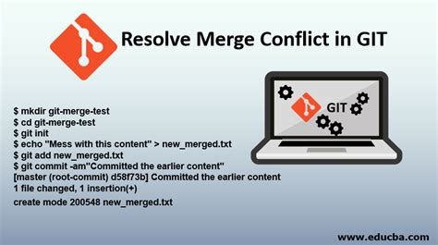
Comparative Advantage
Efficiency: Reduces bandwidth usage by up to 90% for small integrations.
Stability: Eliminates "version mismatch" errors.
Portability: Elements can be moved between different OS environments without breaking.

Slide 8
Applicability in Computer Science
Education: Students can download specific algorithms (e.g., "Dijkstra's Algorithm") to study in isolation.
Microservices: Perfect for building modular backend architectures.
Legacy Systems: Allows updating small parts of a system without rewriting the whole core.

Slide 9

Scalability & Future Scope
AI Integration: Future updates will use AI to recommend compatible elements.
Monetization: A marketplace where developers can sell high-quality, self-sustaining elements.

Slide 10
Albert Einstein
Conclusion
Summary: Element-Hub moves us from "Monolithic Development" to "Atomic Development."
Final Impact: It saves time, reduces errors, and makes code sharing truly modular.
“Strive not to be a success, but rather to be of value.”

